Slide 1
Module 3
MEMORY MANAGEMENT AND VIRTUAL MEMORY

Slide 2
Logical and physical address space
Logical Address
It is a virtual address generated by the CPU while a program is running.
It is referred to as a virtual address because it does not exist physically.
Using this address, the CPU access the actual address or physical address inside the memory, and data is fetched from there.
The hardware device called Memory Management Unit (MMU) is used for mapping this logical address to the physical address.
The set of all logical addresses generated by the CPU for a program is called the logical address space.
Logical address-Used in network layer-IP address-32 bit address e.g. IP address 190.10.134.76

Slide 3
Physical Address
Physical Address is the actual address of the data inside the memory.
The logical address is a virtual address and the program needs physical memory for its execution.
The user never deals with the Physical Address.
The user program generates the logical address and is mapped to the physical address by the Memory Management Unit(MMU).
The set of all physical addresses corresponding to the logical addresses in the logical address space is called the physical address space.
Datalink layer-to identify computer-mac address-05-0h-77-7i-88-9a-hexadecimal value-48 bit address

Slide 4
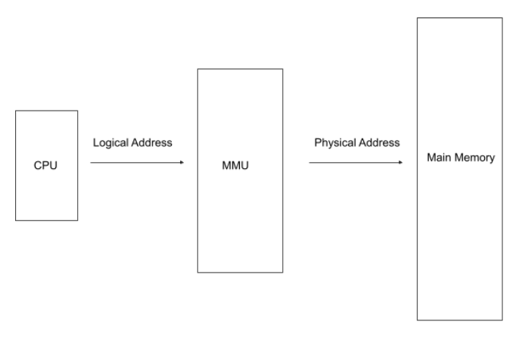

Slide 5
Comparison between Logical Address and Physical Address
Logical Address | Physical Address
It is a virtual address. | It is the actual location in the memory.
It is visible to the user. | It is not visible to the user.
It is generated by the CPU. | It is computed by the MMU.
It is used by the user to access the physical address inside the memory. | It is not accessible directly by the user.
The set of all logical addresses generated by the CPU is called the logical address space. | The set of all physical addresses corresponding to the logical addresses in the logical address space is called the physical address space.

Slide 6
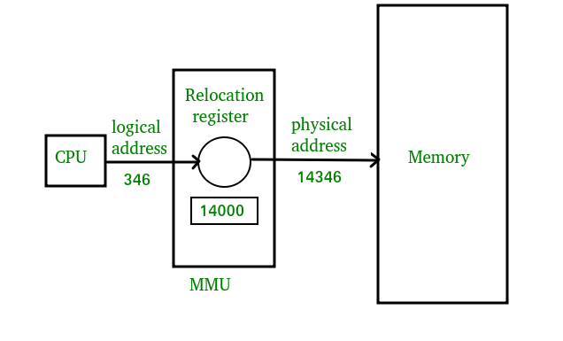
MMU Operation

Slide 7
Swapping
It is mechanism in which a process can be swapped temporarily out of main memory to secondary memory and secondary memory to main memory.
The exchange of two or more objects is referred to as swapping.
For example, programming can swap information between two variables or elements.
Swapping may particularly refer to a primitive method of memory management used in computer systems.
We swap processes from secondary memory to main memory or from main memory to secondary memory.
Swapping in the operating systems is a memory management technique in which we swap processes from secondary memory to main memory or from main memory to secondary memory.

Slide 8
The objective of swapping in the operating system is to increase the degree of multi-programming and to increase main memory utilization.
There are two steps in the process of Swapping in the operating system:
Swap In: Swap-in the process of bringing a process from secondary storage/hard-disc to main memory (RAM).
Swap Out: Swap-out takes the process out of the Main memory and puts it in the secondary storage.

Slide 9
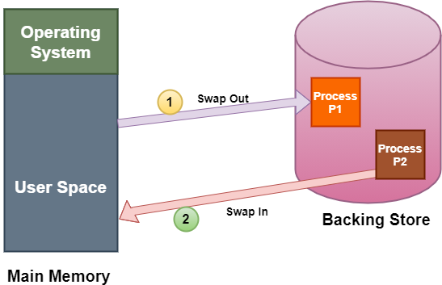
Fig.Swapping

Slide 10
Advantages of Swapping
Swapping processes improve the degree of multi-programming.
It provides advantages of Virtual Memory for the user.
Swapping reduces the average waiting time for the process because it allows multiple processes to execute simultaneously.
It helps in better memory management and efficient utilization of RAM.

Slide 11
Disadvantages of Swapping
The swapping algorithm must be perfect; otherwise, the number of Page Faults will increase, and performance will decrease.
Inefficiency will occur when there are common/shared resources between many processes.
The user will lose information if there is heavy swapping and the computer loses its power.

Slide 12
Contiguous Memory Allocation
In the Contiguous Memory Allocation, each process is contained in a single contiguous section of memory. In this memory allocation, all the available memory space remains together in one place which implies that the freely available memory partitions are not spread over here and there across the whole memory space.
In Contiguous memory allocation which is a memory management technique, whenever there is a request by the user process for the memory then a single section of the contiguous memory block is given to that process according to its requirement. Contiguous Memory allocation is achieved just by dividing the memory into the fixed-sized partition.
The memory can be divided either in the fixed-sized partition or in the variable-sized partition in order to allocate contiguous space to user processes.

Slide 13
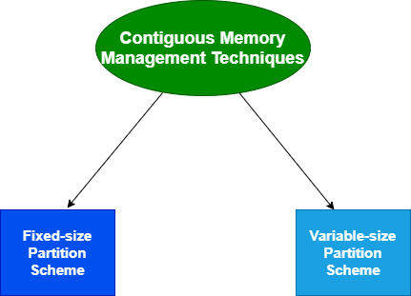

Slide 14
Fixed-size Partition Scheme
This technique is also known as Static partitioning.
In this scheme, the system divides the memory into fixed-size partitions.
The partitions may or may not be the same size.
The size of each partition is fixed as indicated by the name of the technique and it cannot be changed.
In this partition scheme, each partition may contain exactly one process.
There is a problem that this technique will limit the degree of multiprogramming because the number of partitions will basically decide the number of processes.
Whenever any process terminates then the partition becomes available for another process.

Slide 15
Internal fragmentation
Limit in process size
Limitation on degree of multiprogramming
External fragmentation

Slide 16
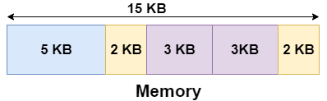
Example
Let's take an example of fixed size partitioning scheme, we will divide a memory size of 15 KB into fixed-size partitions:
It is important to note that these partitions are allocated to the processes as they arrive and the partition that is allocated to the arrived process basically depends on the algorithm followed.
If there is some wastage inside the partition then it is termed Internal Fragmentation.

Slide 17
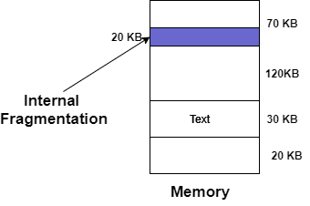

Slide 18
Variable-size Partition Scheme
This scheme is also known as Dynamic partitioning and is came into existence to overcome the drawback i.e internal fragmentation that is caused by Static partitioning. In this partitioning, scheme allocation is done dynamically.
The size of the partition is not declared initially.
Whenever any process arrives, a partition of size equal to the size of the process is created and then allocated to the process.
Thus the size of each partition is equal to the size of the process.
As partition size varies according to the need of the process so in this partition scheme there is no internal fragmentation.

Slide 19
No internal fragmentation
No limitation on number of processes

Slide 20
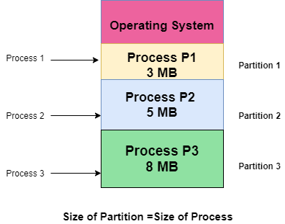

Slide 21
Paging
Paging is a memory management scheme that eliminates the need for contiguous allocation of physical memory.
The process of retrieving processes in the form of pages from the secondary storage into the main memory is known as paging.
The basic purpose of paging is to separate each procedure into pages.
Additionally, frames will be used to split the main memory.
This scheme permits the physical address space of a process to be non – contiguous.
Let us look some important terminologies:
Logical Address or Virtual Address (represented in bits): An address generated by the CPU
Logical Address Space or Virtual Address Space( represented in words or bytes): The set of all logical addresses generated by a program
Physical Address (represented in bits): An address actually available on memory unit
Physical Address Space (represented in words or bytes): The set of all physical addresses corresponding to the logical addresses

Slide 22
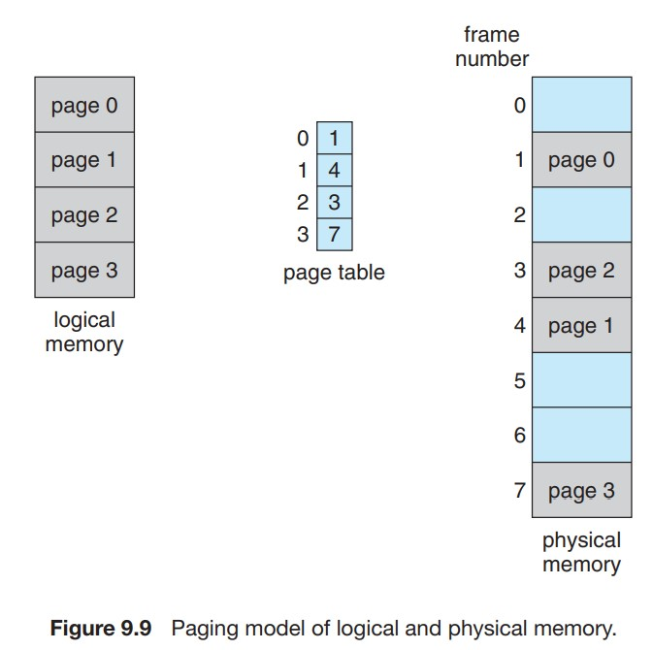

Slide 23
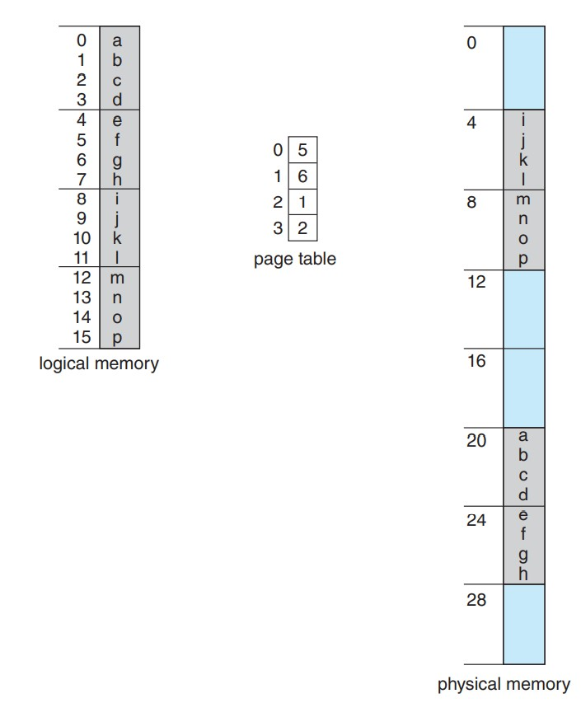
Fig. Paging example a 32 byte memory with 4-byte pages

Slide 24
Example:
If Logical Address = 31 bit, then Logical Address Space = 2³¹ words = 2 G words (1 G = 2³⁰)
If Logical Address Space = 128 M words = 2⁷ * 2²⁰ words, then Logical Address = log₂ 2²⁷ = 27 bits
If Physical Address = 22 bit, then Physical Address Space = 2²² words = 4 M words (1 M = 2²⁰)
If Physical Address Space = 16 M words = 2⁴ * 2²⁰ words, then Physical Address = log₂ 2²⁴ = 24 bits
The mapping from virtual to physical address is done by the memory management unit (MMU) which is a hardware device and this mapping is known as paging technique.

Slide 25
The Physical Address Space is conceptually divided into a number of fixed-size blocks, called frames.
The Logical address Space is also splitted into fixed-size blocks, called pages.
Page Size = Frame Size
Let us consider an example:
Physical Address = 12 bits, then Physical Address Space = 4 K words
Logical Address = 13 bits, then Logical Address Space = 8 K words
Page size = frame size = 1 K words (assumption)

Slide 26
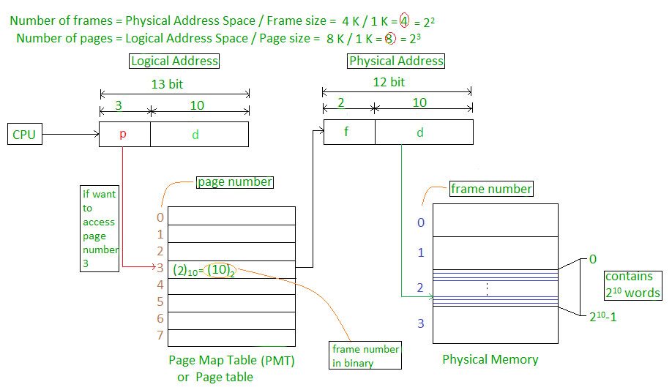

Slide 27
CPU is divided into
Page number(p): Number of bits required to represent the pages in Logical Address Space or Page number
Page offset(d): Number of bits required to represent particular word in a page or page size of Logical Address Space or word number of a page or page offset.
Physical Address is divided into
Frame number(f): Number of bits required to represent the frame of Physical Address Space or Frame number.
Frame offset(d): Number of bits required to represent particular word in a frame or frame size of Physical Address Space or word number of a frame or frame offset.

Slide 28
The hardware implementation of page table can be done by using dedicated registers.
But the usage of register for the page table is satisfactory only if page table is small.
If page table contain large number of entries then we can use TLB(translation Look-aside buffer), a special, small, fast look up hardware cache.
The TLB is associative, high speed memory.
Each entry in TLB consists of two parts: a tag and a value.
When this memory is used, then an item is compared with all tags simultaneously.
If the item is found, then corresponding value is returned.

Slide 29
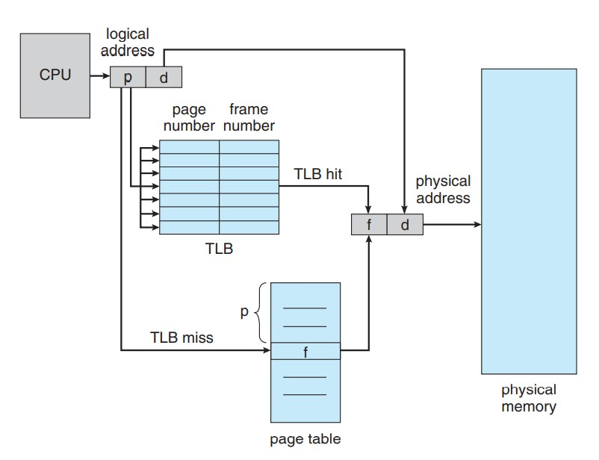
Translation Lookaside Buffer

Slide 30
Structure of Page Table
The data structure that is used by the virtual memory system in the operating system of a computer in order to store the mapping between physical and logical addresses is commonly known as Page Table.
As we had already told you that the logical address that is generated by the CPU is translated into the physical address with the help of the page table.
Thus page table mainly provides the corresponding frame number (base address of the frame) where that page is stored in the main memory.

Slide 31
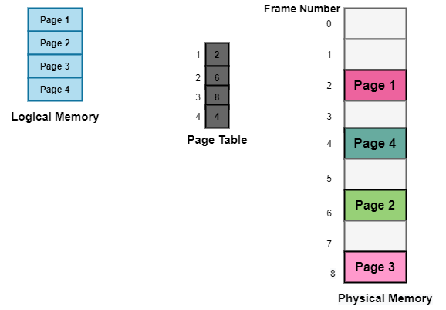
The above diagram shows the paging model of Physical and logical memory.

Slide 32
Q.1 A paging scheme using TLB. TLB Access Time 10 ns and main memory access time takes 50 ns. What is Effective Memory Access Time (in ns) if TLB hit ratio is 90% and there is no page fault?

Slide 33
Characteristics of the Page Table
Some of the characteristics of the Page Table are as follows:
It is stored in the main memory.
Generally; the Number of entries in the page table = the Number of Pages in which the process is divided.
PTBR means page table base register and it is basically used to hold the base address for the page table of the current process.
Each process has its own independent page table.

Slide 34
Techniques used for Structuring the Page Table
Some of the common techniques that are used for structuring the Page table are as follows:
Hierarchical Paging
Hashed Page Tables
Inverted Page Tables

Slide 35
Hierarchical Paging
Another name for Hierarchical Paging is multilevel paging.
There might be a case where the page table is too big to fit in a contiguous space, so we may have a hierarchy with several levels.
In this type of Paging the logical address space is broke up into Multiple page tables.
Hierarchical Paging is one of the simplest techniques and for this purpose, a two-level page table and three-level page table can be used.

Slide 36
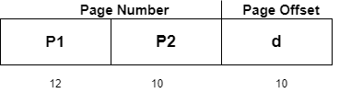
Two Level Page Table
Consider a system having 32-bit logical address space and a page size of 1 KB and it is further divided into:
Page Number consisting of 22 bits.
Page Offset consisting of 10 bits.
As we page the Page table, the page number is further divided into :
Page Number consisting of 12 bits.
Page Offset consisting of 10 bits.
Thus the Logical address is as follows:

Slide 37
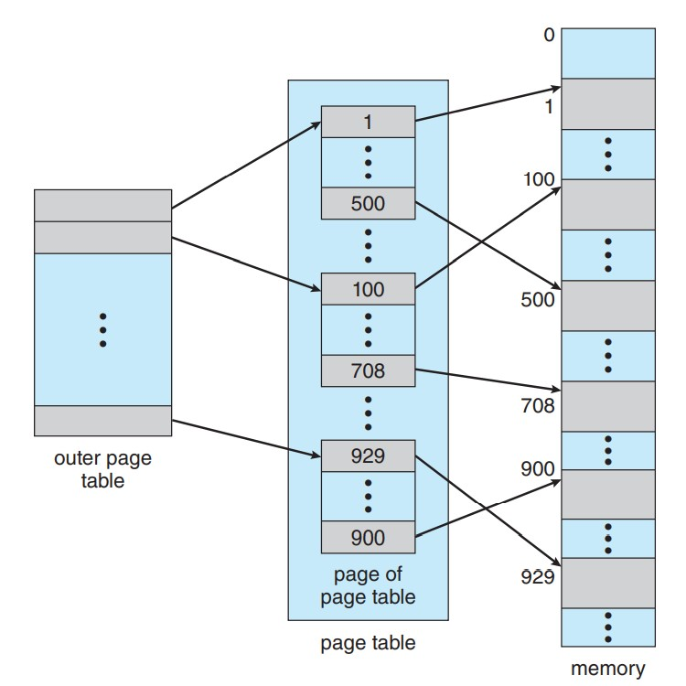
Fig. Two level page scheme

Slide 38
In the above diagram,
P1 is an index into the Outer Page table.
P2 indicates the displacement within the page of the Inner page Table.
As address translation works from outer page table inward so is known as forward-mapped Page Table.
Below given figure below shows the Address Translation scheme for a two-level page table

Slide 39
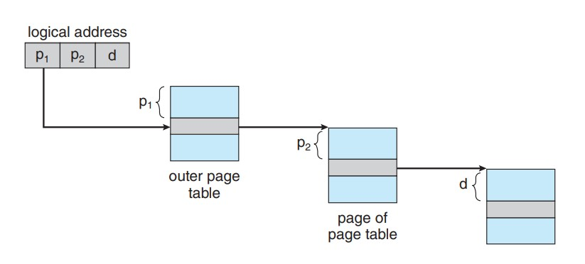
Fig. Address translation for a two-level 32-bit paging architecture

Slide 40


Three Level Page Table
For a system with 64-bit logical address space, a two-level paging scheme is not appropriate.
Let us suppose that the page size, in this case, is 4KB.
If in this case, we will use the two-page level scheme then the addresses will look like this:
Thus in order to avoid such a large table, there is a solution and that is to divide the outer page table, and then it will result in a Three-level page table:

Slide 41
Hashed Page Tables
Hashed page tables are a technique for structuring page tables in memory.
In a hashed page table, the virtual addresses are hashed into the hash table.
Each element in the table comprises a linked list of elements to avoid collisions.
The hash value used is the virtual page number, i.e., all the bits that are not part of the page offset.
Each element in the hash table has the virtual page number, the value of the mapped page, and a pointer to the next element.
Hashed page tables are common in address spaces greater than 32 bits. For each element in the hash table, there are three fields available,

Slide 42
The virtual Page Number (which is the hash value).
The value of the mapped page frame.
A pointer to the next element in the linked list.
The virtual page number is matched against the first field, i.e., the virtual address, and if a match is found, the corresponding mapped address in the second field is used to form the desired memory address.
If a match is not found, the linked list is traversed using the next pointer until a match is found.
Though we can structure the large page table using the multilevel page table, it would consist of several levels that increase the page table's complexity.

Slide 43
Working of Hashed Page Tables
The CPU generates a logical address for the page it needs. Now, this logical address needs to be mapped to the physical address.
This logical address has two entries, i.e., a page number (P₃) and an offset, as shown below.
The page number from the logical address is directed to the hash function.
The hash function produces a hash value corresponding to the page number.
This hash value directs to an entry in the hash table.
As we have studied earlier, each entry in the hash table has a link list. Here the page number is compared with the first element's first entry.
If a match is found, then the second entry is checked.

Slide 44
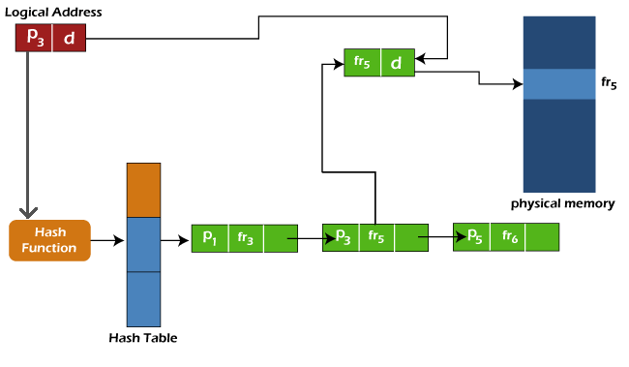

Slide 45
In this example, the logical address includes page number P₃ which does not match the first element of the link list as it includes page number P₁.
So we will move ahead and check the next element; now, this element has a page number entry, i.e., P3, so further, we will check the frame entry of the element, which is fr₅.
We will append the offset provided in the logical address to this frame number to reach the page's physical address.
So, this is how the hashed page table works to map the logical address to the physical address.

Slide 46
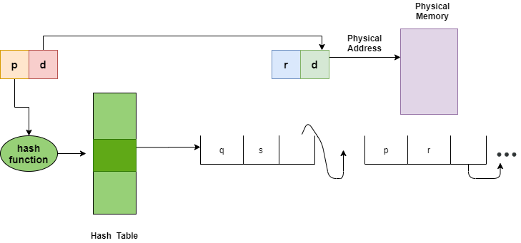
Fig.Hashed Page Table

Slide 47
Inverted Page Tables
The Inverted Page table basically combines A page table and A frame table into a single data structure.
There is one entry for each virtual page number and a real page of memory
And the entry mainly consists of the virtual address of the page stored in that real memory location along with the information about the process that owns the page.
Though this technique decreases the memory that is needed to store each page table; but it also increases the time that is needed to search the table whenever a page reference occurs.

Slide 48
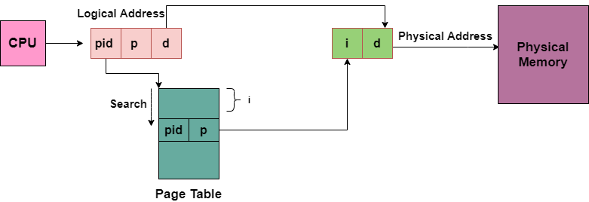
Given below figure shows the address translation scheme of the Inverted Page Table:
In this, we need to keep the track of process id of each entry, because many processes may have the same logical addresses.
Also, many entries can map into the same index in the page table after going through the hash function. Thus chaining is used in order to handle this.

Slide 49
Segmentation
Segmentation divides processes into smaller subparts known as modules.
Segmentation divides the user program and the secondary memory into uneven-sized blocks known as Segments.
The divided segments need not be placed in contiguous memory.
Since there is no contiguous memory allocation, internal fragmentation does not take place.
The length of the segments of the program and memory is decided by the purpose of the segment in the user program.
We can say that logical address space or the main memory is a collection of segments.

Slide 50
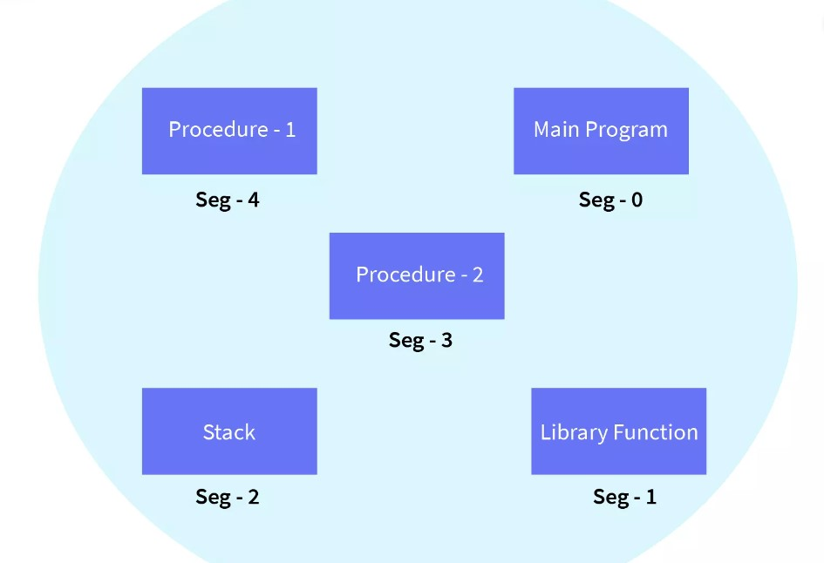

Slide 51
Why segmentation required?
Segmentation came into existence because of the problems in the paging technique.
In the case of the paging technique, a function or piece of code is divided into pages without considering that the relative parts of code can also get divided.
Hence, for the process in execution, the CPU must load more than one page into the frames so that the complete related code is there for execution.
Paging took more pages for a process to be loaded into the main memory.
Hence, segmentation was introduced in which the code is divided into modules so that related code can be combined in one single block.

Slide 52
Segment Table and its Uses
Segment Table is used to store the information of all segments of the process. As we know, the CPU generates a logical address and for its conversion to the physical address, a segment table is used. The mapping of a two-dimensional Logical address to the one-dimensional Physical address is done using the segment table.
The Segment Table has two components:
Segment Base: The segment base is also known as the base address of a segment. The segment base contains the starting physical address of the segments residing in the memory.
Segment Limit: The segment limit is also known as segment offset. The segment contains the specific length of the segment.

Slide 53
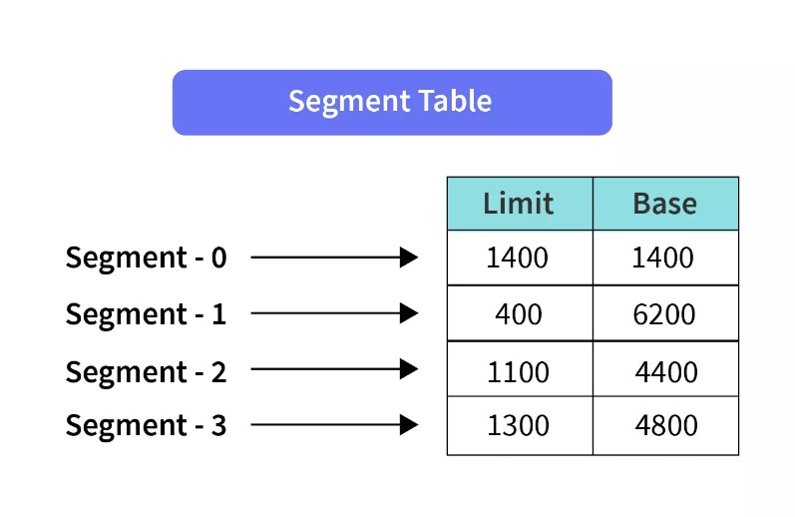
STBR: STBR stands for Segment Table Base Register. STBR stores the base address of the segment table.
STLR: STLR stands for Segment Table Length Register. STLR stores the number of segments used by a program.

Slide 54
Characteristics of Segmentation
Segmentation partitions the program into variable-sized blocks or segments.
Partition size depends upon the type and length of modules.
Segmentation is done considering that the relative data should come in a single segment.
Segments of the memory may or may not be stored in a continuous manner depending upon the segmentation technique chosen.
Operating System maintains a segment table for each process.

Slide 55
Example of segmentation
Let us assume we have five segments namely: Segment-0, Segment-1, Segment-2, Segment-3, and Segment-4. Initially, before the execution of the process, all the segments of the process are stored in the physical memory space. We have a segment table as well. The segment table contains the beginning entry address of each segment (denoted by base). The segment table also contains the length of each of the segments (denoted by limit).
As shown in the image below, the base address of Segment-0 is 1400 and its length is 1000, the base address of Segment-1 is 6300 and its length is 400, the base address of Segment-2 is 4300 and its length is 400, and so on.
The pictorial representation of the above segmentation with its segment table is shown below.

Slide 56
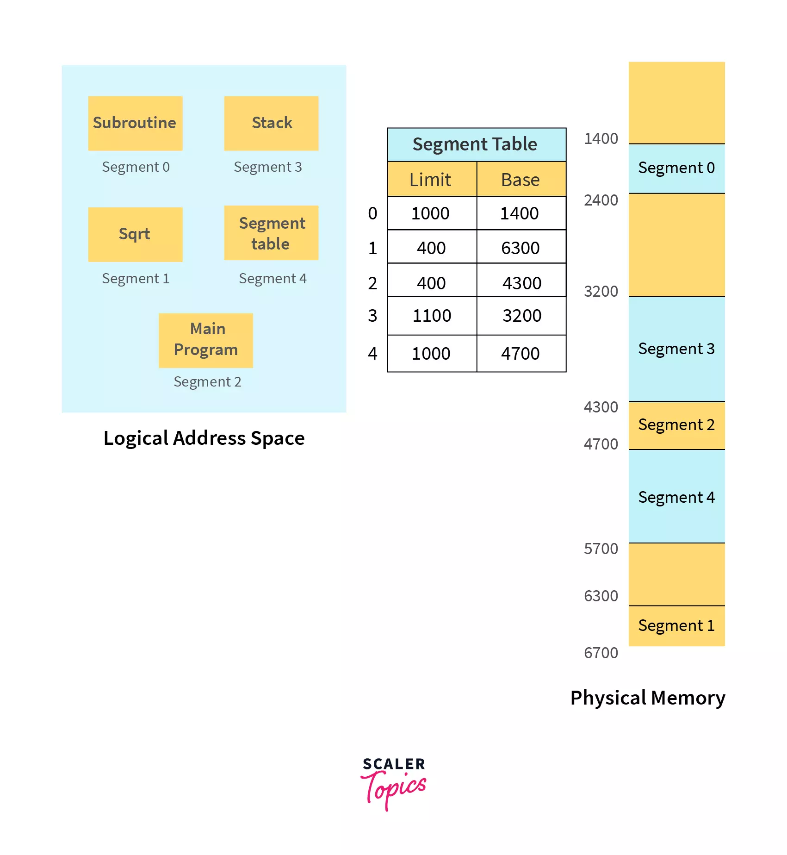



Slide 57
Virtual memory
Virtual memory is hardware technique where the system appears to have more memory that it actually does.
It is a storage mechanism which offers user an illusion of having a very big main memory.
It is done by treating a part of secondary memory as the main memory.
In Virtual memory, the user can store processes with a bigger size than the available main memory.
Therefore, instead of loading one long process in the main memory, the OS loads the various parts of more than one process in the main memory.
Virtual memory is mostly implemented with demand paging and demand segmentation.

Slide 58
Why Need Virtual Memory?
Here, are reasons for using virtual memory:
Whenever your computer doesn’t have space in the physical memory it writes what it needs to remember to the hard disk in a swap file as virtual memory.
If a computer running Windows needs more memory/RAM, then installed in the system, it uses a small portion of the hard drive for this purpose.

Slide 59
How Virtual Memory Works?
It is used whenever some pages require to be loaded in the main memory for the execution, and the memory is not available for those many pages.
So, in that case, instead of preventing pages from entering in the main memory, the OS searches for the RAM space that are minimum used in the recent times or that are not referenced into the secondary memory to make the space for the new pages in the main memory.
Let’s understand virtual memory management with the help of one example.

Slide 60
For example:
Let’s assume that an OS requires 300 MB of memory to store all the running programs. However, there’s currently only 50 MB of available physical memory stored on the RAM.
The OS will then set up 250 MB of virtual memory and use a program called the Virtual Memory Manager(VMM) to manage that 250 MB.
So, in this case, the VMM will create a file on the hard disk that is 250 MB in size to store extra memory that is required.
The OS will now proceed to address memory as it considers 300 MB of real memory stored in the RAM, even if only 50 MB space is available.
It is the job of the VMM to manage 300 MB memory even if just 50 MB of real memory space is available.

Slide 61
Demand Paging
Every process in the virtual memory contains lots of pages and in some cases, it might not be efficient to swap all the pages for the process at once.
Because it might be possible that the program may need only a certain page for the application to run.
Let us take an example here, suppose there is a 500 MB application and it may need as little as 100MB pages to be swapped, so in this case, there is no need to swap all pages at once.
The demand paging system is somehow similar to the paging system with swapping where processes mainly reside in the main memory(usually in the hard disk).

Slide 62
Thus demand paging is the process that solves the above problem only by swapping the pages on Demand. This is also known as lazy swapper( It never swaps the page into the memory unless it is needed).
Swapper that deals with the individual pages of a process are referred to as Pager.
Demand Paging is a technique in which a page is usually brought into the main memory only when it is needed or demanded by the CPU.
Initially, only those pages are loaded that are required by the process immediately.
Those pages that are never accessed are thus never loaded into the physical memory.
Whenever a page is needed? make a reference to it;
If the reference is invalid then abort it.
If the page is Not-in-memory then bring it to memory.

Slide 63
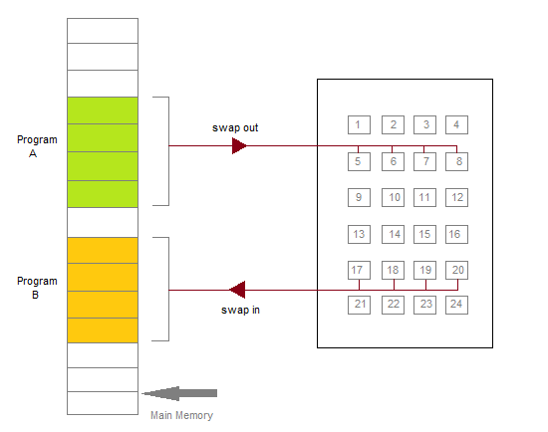
Figure: Transfer of a Paged Memory to the contiguous disk space

Slide 64
Valid-Invalid Bit
Some form of hardware support is used to distinguish between the pages that are in the memory and the pages that are on the disk. Thus for this purpose Valid-Invalid scheme is used:
With each page table entry, a valid-invalid bit is associated( where 1 indicates in the memory and 0 indicates not in the memory)
Initially, the valid-invalid bit is set to 0 for all table entries.
If the bit is set to "valid", then the associated page is both legal and is in memory.
If the bit is set to "invalid" then it indicates that the page is either not valid or the page is valid but is currently not on the disk.

Slide 65
For the pages that are brought into the memory, the page table is set as usual.
But for the pages that are not currently in the memory, the page table is either simply marked as invalid or it contains the address of the page on the disk.
During the translation of address, if the valid-invalid bit in the page table entry is 0 then it leads to page fault.

Slide 66
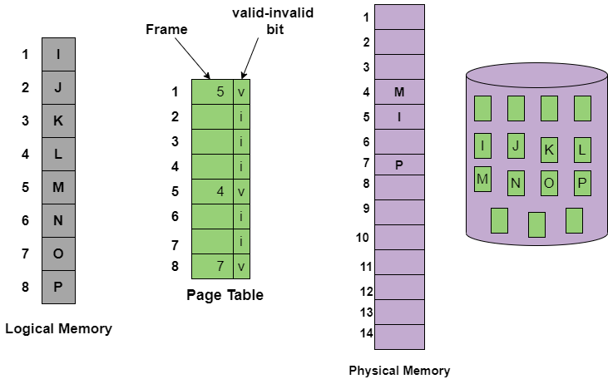
The above figure is to indicates the page table when some pages are not in the main memory.

Slide 67
How Demand Paging Works?
First of all the components that are involved in the Demand paging process are as follows:
Main Memory
CPU
Secondary Memory
Interrupt
Physical Address space
Logical Address space
Operating System
Page Table

Slide 68
When the process requires any of the pages that are not loaded into the memory, a page fault trap is triggered and the following steps are followed,
The memory address which is requested by the process is first checked, to verify the request made by the process.
If it is found to be invalid, the process is terminated.
In case the request by the process is valid, a free frame is located, possibly from a free-frame list, where the required page will be moved.

Slide 69
4.A new operation is scheduled to move the necessary page from the disk to the specified memory location. ( This will usually block the process on an I/O wait, allowing some other process to use the CPU in the meantime. )
5.When the I/O operation is complete, the process's page table is updated with the new frame number, and the invalid bit is changed to valid.
6.The instruction that caused the page fault must now be restarted from the beginning.

Slide 70
Advantages of Demand Paging
The benefits of using the Demand Paging technique are as follows:
With the help of Demand Paging, memory is utilized efficiently.
Demand paging avoids External Fragmentation.
Less Input/Output is needed for Demand Paging.
This process is not constrained by the size of physical memory.
With Demand Paging it becomes easier to share the pages.
With this technique, portions of the process that are never called are never loaded.
No compaction is required in demand Paging.

Slide 71
Disadvantages of Demand paging
There is an increase in overheads due to interrupts and page tables.
Memory access time in demand paging is longer.

Slide 72
Pure Demand Paging
In some cases when initially no pages are loaded into the memory, pages in such cases are only loaded when are demanded by the process by generating page faults. It is then referred to as Pure Demand Paging.
In the case of pure demand paging, there is not even a single page that is loaded into the memory initially. Thus pure demand paging causes the page fault.
When the execution of the process starts with no pages in the memory, then the operating system sets the instruction pointer to the first instruction of the process and that is on a non-memory resident page and then in this case the process immediately faults for the page.

Slide 73
After that when this page is brought into the memory then the process continues its execution, page fault is necessary until every page that it needs is in the memory.
And at this point, it can execute with no more faults.
This scheme is referred to as Pure Demand Paging: means never bring a page into the memory until it is required.

Slide 74
Performance of Demand Paging
Demand paging can significantly affect the performance of a computer system.
To see why, let’s compute the effective access time for a demand-paged memory.
Assume the memory-access time, denoted ma, is 10 nanoseconds.
As long as we have no page faults, the effective access time is equal to the memory access time.
If, however, a page fault occurs, we must first read the relevant page from secondary storage and then access the desired word.
Let p be the probability of a page fault (0 ≤ p ≤ 1). We would expect p to be close to zero— that is, we would expect to have only a few page faults. The effective access time is then
effective access time = (1 − p) × ma + p × page fault time.

Slide 75
To compute the effective access time, we must know how much time is needed to service a page fault. A page fault causes the following sequence to occur:
Trap to the operating system.
Save the registers and process state.
Determine that the interrupt was a page fault.
Check that the page reference was legal, and determine the location of the page in secondary storage.
Issue a read from the storage to a free frame:
Wait in a queue until the read request is serviced.
Wait for the device seek and/or latency time.
Begin the transfer of the page to a free frame.

Slide 76
6.While waiting, allocate the CPU core to some other process.
7.Receive an interrupt from the storage I/O subsystem (I/O completed).
8.Save the registers and process state for the other process (if step 6 is executed).
9.Determine that the interrupt was from the secondary storage device.
10.Correct the page table and other tables to show that the desired page is now in memory.
11.Wait for the CPU core to be allocated to this process again.
12.Restore the registers, process state, and new page table, and then resume the interrupted instruction.

Slide 77
Not all of these steps are necessary in every case. For example, we are assuming that, in step 6, the CPU is allocated to another process while the I/O occurs.
This arrangement allows multiprogramming to maintain CPU utilization but requires additional time to resume the page-fault service routine when the I/O transfer is complete.
In any case, there are three major task components of the page-fault service time:
1. Service the page-fault interrupt.
2. Read in the page.
3. Restart the process.

Slide 78
The first and third tasks can be reduced, with careful coding, to several hundred instructions.
These tasks may take from 1 to 100 microseconds each. Let’s consider the case of HDDs being used as the paging device.
The page switch time will probably be close to 8 milliseconds.
(A typical hard disk has an average latency of 3 milliseconds, a seek of 5 milliseconds, and a transfer time of 0.05 milliseconds.
Thus, the total paging time is about 8 milliseconds, including hardware and software time.) Remember also that we are looking at only the device-service time.
If a queue of processes is waiting for the device, we have to add queuing time as we wait for the paging device to be free to service our request, increasing even more the time to page in

Slide 79
With an average page-fault service time of 8 milliseconds and a memory access time of 200 nanoseconds, the effective access time in nanoseconds is
effective access time = (1 − p) × (200) + p (8 milliseconds)
= (1 − p) × 200 + p × 8,000,000
= 200 + 7,999,800 × p.

Slide 80
We see, then, that the effective access time is directly proportional to the page-fault rate.
If one access out of 1,000 causes a page fault, the effective access time is 8.2 microseconds.
The computer will be slowed down by a factor of 40 because of demand paging!
If we want performance degradation to be less than 10 percent, we need to keep the probability of page faults at the following level:
220 > 200 + 7,999,800 × p,
20 > 7,999,800 × p,
p < 0.0000025

Slide 81
Page replacement algorithm
Page Replacement Algorithm decides which page to remove, also called swap out when a new page needs to be loaded into the main memory.
Page Replacement happens when a requested page is not present in the main memory and the available space is not sufficient for allocation to the requested page.
When the page that was selected for replacement was paged out, and referenced again, it has to read in from disk, and this requires for I/O completion.
This process determines the quality of the page replacement algorithm: the lesser the time waiting for page-ins, the better is the algorithm.

Slide 82
A page replacement algorithm tries to select which pages should be replaced so as to minimize the total number of page misses.
There are many different page replacement algorithms.
These algorithms are evaluated by running them on a particular string of memory reference and computing the number of page faults.
The fewer is the page faults the better is the algorithm for that situation.
If a process requests for page and that page is found in the main memory then it is called page hit , otherwise page miss or page fault .

Slide 83
Why Need Page Replacement Algorithms?
To understand why we need page replacement algorithms, we first need to know about page faults. Let’s see what is a page fault.
Page Fault: A Page Fault occurs when a program running in CPU tries to access a page that is in the address space of that program, but the requested page is currently not loaded into the main physical memory, the RAM of the system.
Since the actual RAM is much less than the virtual memory the page faults occur. So whenever a page fault occurs, the Operating system has to replace an existing page in RAM with the newly requested page. In this scenario, page replacement algorithms help the Operating System in deciding which page to replace. The primary objective of all the page replacement algorithms is to minimize the number of page faults.

Slide 84
Page Replacement Algorithms
First In First Out (FIFO)
FIFO algorithm is the simplest of all the page replacement algorithms.
In this, we maintain a queue of all the pages that are in the memory currently.
The oldest page in the memory is at the front-end of the queue and the most recent page is at the back or rear-end of the queue.
Whenever a page fault occurs, the operating system looks at the front-end of the queue to know the page to be replaced by the newly requested page.
It also adds this newly requested page at the rear-end and removes the oldest page from the front-end of the queue.

Slide 85
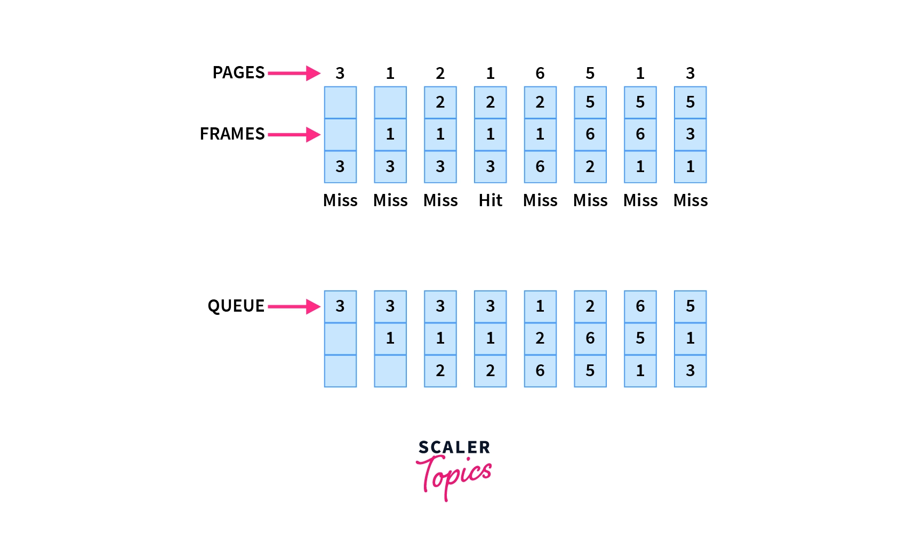

Example: Consider the page reference string as 3, 1, 2, 1, 6, 5, 1, 3 with 3-page frames. Let’s try to find the number of page faults:

Slide 86
Belady's anomaly: Generally if we increase the number of frames in the memory, the number of page faults should decrease due to obvious reasons. Belady’s anomaly refers to the phenomena where increasing the number of frames in memory, increases the page faults as well.
Initially, all of the slots are empty so page faults occur at 3,1,2.
Page faults = 3
When page 1 comes, it is in the memory so no page fault occurs.
Page faults = 3
When page 6 comes, it is not present and a page fault occurs. Since there are no empty slots, we remove the front of the queue, i.e 3.
Page faults = 4

Slide 87
When page 5 comes, it is also not present and hence a page fault occurs. The front of the queue i.e 1 is removed.
Page faults = 5
When page 1 comes, it is not found in memory and again a page fault occurs. The front of the queue i.e 2 is removed.
Page faults = 6
When page 3 comes, it is again not found in memory, a page fault occurs, and page 6 is removed being on top of the queue
Total page faults = 7

Slide 88
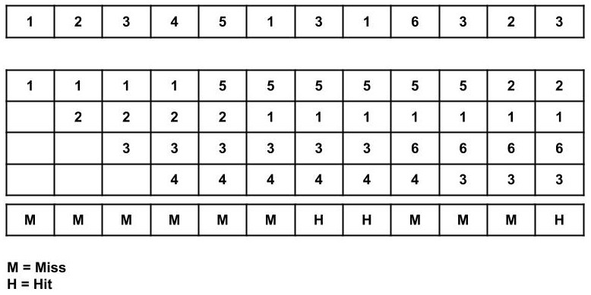
2.Consider the page reference string of size 12: 1, 2, 3, 4, 5, 1, 3, 1, 6, 3, 2, 3 with frame size 4(i.e. maximum 4 pages in a frame).

Slide 89
Total Page Fault = 9
Initially, all 4 slots are empty, so when 1, 2, 3, 4 came they are allocated to the empty slots in order of their arrival. This is page fault as 1, 2, 3, 4 are not available in memory.
When 5 comes, it is not available in memory so page fault occurs and it replaces the oldest page in memory, i.e., 1.
When 1 comes, it is not available in memory so page fault occurs and it replaces the oldest page in memory, i.e., 2.
When 3,1 comes, it is available in the memory, i.e., Page Hit, so no replacement occurs.
When 6 comes, it is not available in memory so page fault occurs and it replaces the oldest page in memory, i.e., 3.

Slide 90
When 3 comes, it is not available in memory so page fault occurs and it replaces the oldest page in memory, i.e., 4.
When 2 comes, it is not available in memory so page fault occurs and it replaces the oldest page in memory, i.e., 5.
When 3 comes, it is available in the memory, i.e., Page Hit, so no replacement occurs.
Page Fault ratio = 9/12 i.e. total miss/total possible cases

Slide 91
Optimal Page Replacement
Optimal page replacement is the best page replacement algorithm as this algorithm results in the least number of page faults.
In this algorithm, the pages are replaced with the ones that will not be used for the longest duration of time in the future.
In simple terms, the pages that will be referred farthest in the future are replaced in this algorithm.

Slide 92
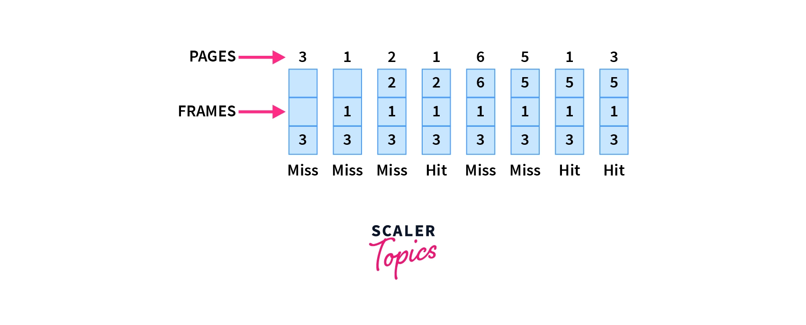

Example: Let6, 5, 1, 3 with 3-page frames as we saw in FIFO. This also helps you understand how Optimal Page replacement works the best.

Slide 93
Initially, since all the slots are empty, pages 3, 1, 2 cause a page fault and take the empty slots.
Page faults = 3
When page 1 comes, it is in the memory and no page fault occurs.
Page faults = 3
When page 6 comes, it is not in the memory, so a page fault occurs and 2 is removed as it is not going to be used again.
Page faults = 4
When page 5 comes, it is also not in the memory and causes a page fault. Similar to above 6 is removed as it is not going to be used again.
page faults = 5
When page 1 and page 3 come, they are in the memory so no page fault occurs.
Total page faults = 5

Slide 94
Advantages
Excellent efficiency
Less complexity
Easy to use and understand
Simple data structures can be used to implement
Used as the benchmark for other algorithms
Disadvantages
More time consuming
Difficult for error handling
Need future awareness of the programs, which is not possible every time

Slide 95
Least Recently Used (LRU) Page Replacement Algorithm
The least recently used page replacement algorithm keeps the track of usage of pages over a period of time.
This algorithm works on the basis of the principle of locality of a reference which states that a program has a tendency to access the same set of memory locations repetitively over a short period of time.
So pages that have been used heavily in the past are most likely to be used heavily in the future also.
In this algorithm, when a page fault occurs, then the page that has not been used for the longest duration of time is replaced by the newly requested page.

Slide 96
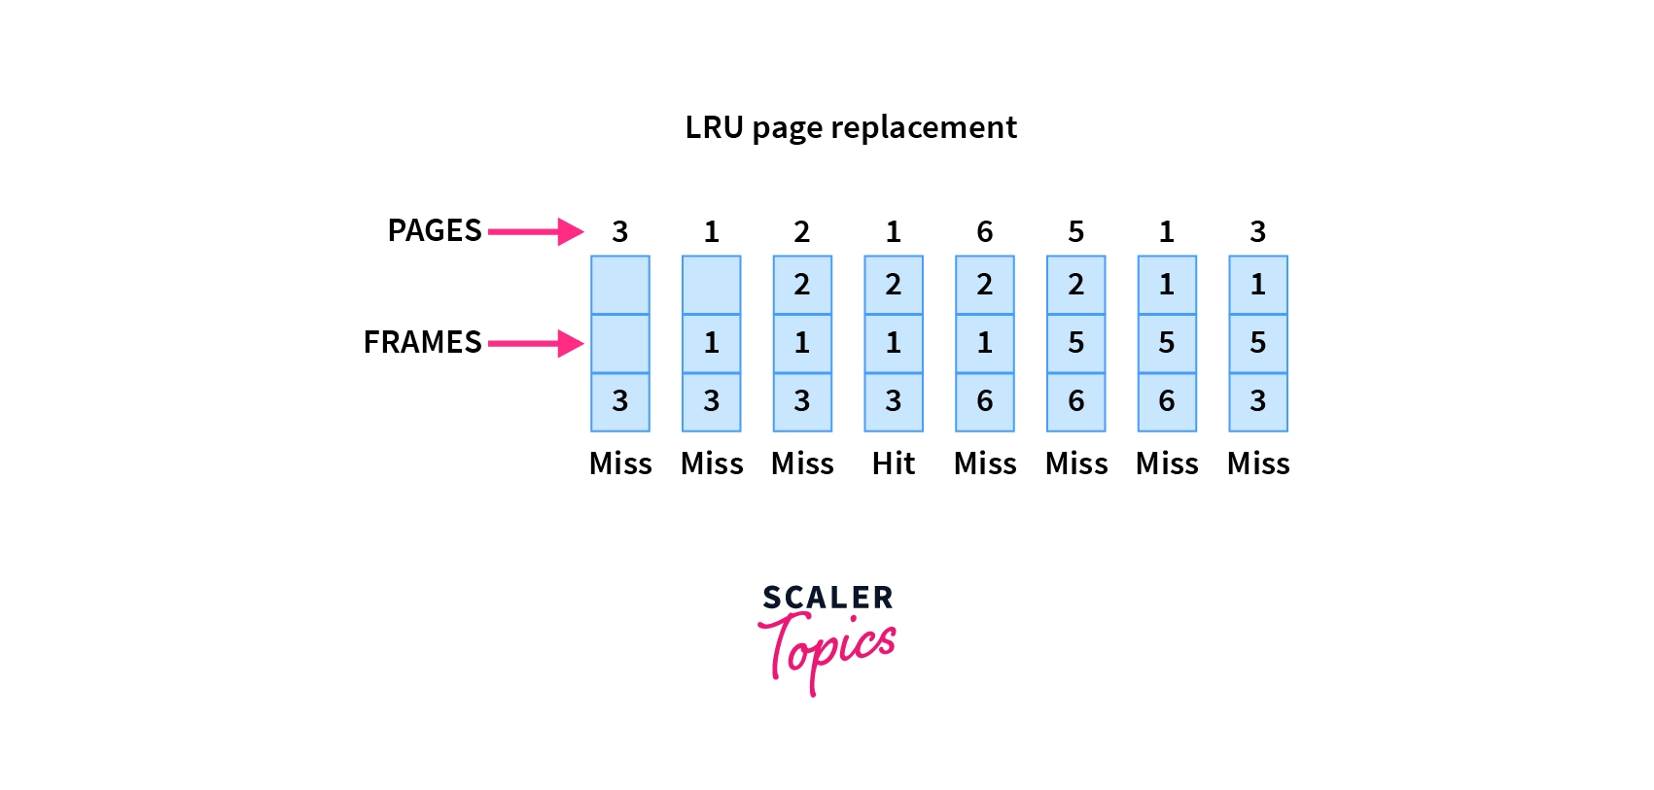

Example: Let’s see the performance of the LRU on the same reference string of 3, 1, 2, 1, 6, 5, 1, 3 with 3-page frames:

Slide 97
Initially, since all the slots are empty, pages 3, 1, 2 cause a page fault and take the empty slots.
Page faults = 3
When page 1 comes, it is in the memory and no page fault occurs.
Page faults = 3
When page 6 comes, it is not in the memory, so a page fault occurs and the least recently used page 3 is removed.
Page faults = 4
When page 5 comes, it again causes a page fault and page 1 is removed as it is now the least recently used page.
Page faults = 5

Slide 98
When page 1 comes again, it is not in the memory and hence page 2 is removed according to the LRU.
Page faults = 6
When page 3 comes, the page fault occurs again and this time page 6 is removed as the least recently used one.
Total page faults = 7
Now in the above example, the LRU causes the same page faults as the FIFO, but this may not always be the case as it will depend upon the series, the number of frames available in memory, etc. In fact, on most occasions, LRU is better than FIFO.

Slide 99
Advantages
It is open for full analysis
Doesn’t suffer from Belady’s anomaly
Often more efficient than other algorithms
Disadvantages
It requires additional data structures to be implemented
More complex
High hardware assistance is required

Slide 100
Last In First Out (LIFO) Page Replacement Algorithm
This is the Last in First Out algorithm and works on LIFO principles.
In this algorithm, the newest page is replaced by the requested page.
Usually, this is done through a stack, where we maintain a stack of pages currently in the memory with the newest page being at the top.
Whenever a page fault occurs, the page at the top of the stack is replaced.

Slide 101
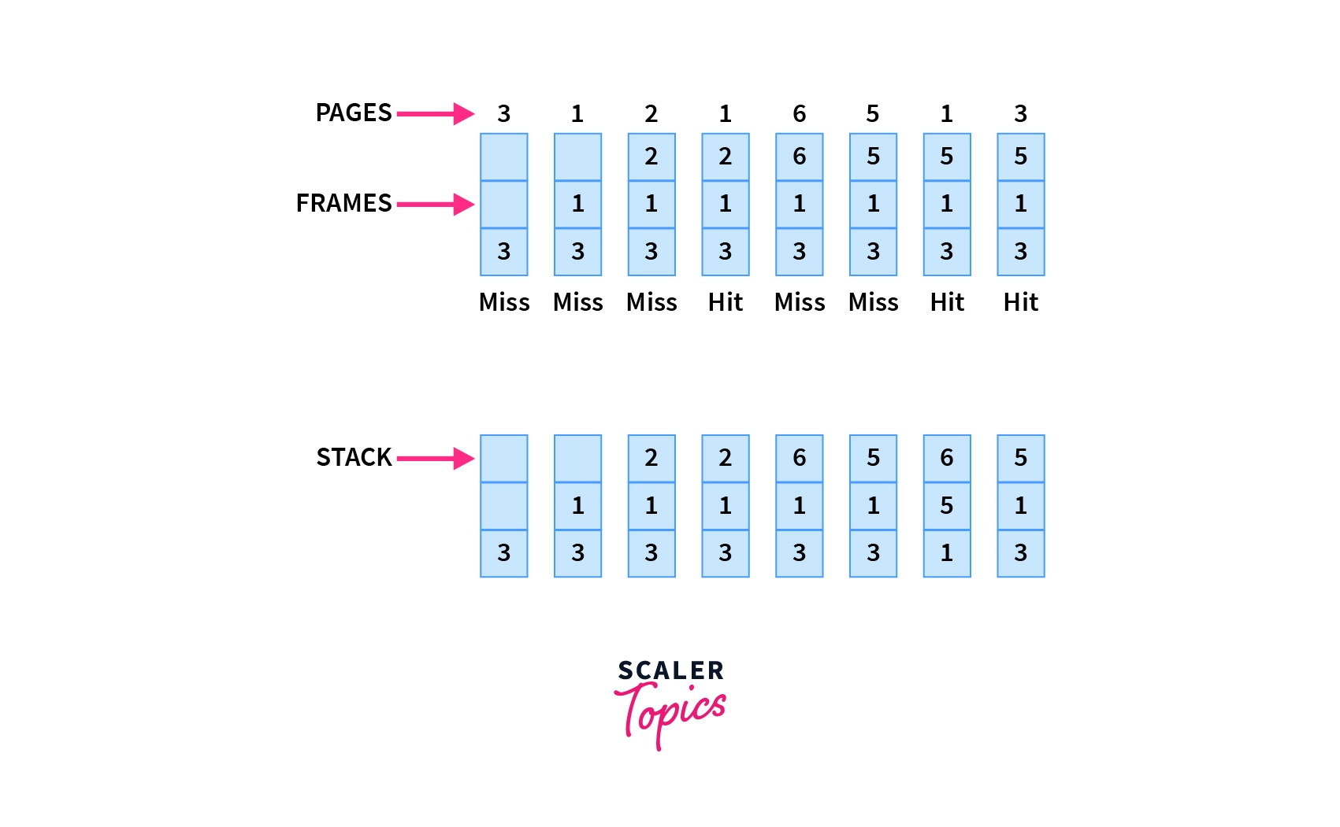

Example: Let’s see how the LIFO performs for our example string of 3, 1, 2, 1, 6, 5, 1, 3 with 3-page frames:

Slide 102
Initially, since all the slots are empty, page 3,1,2 causes a page fault and takes the empty slots.
Page faults = 3
When page 1 comes, it is in the memory and no page fault occurs.
Page faults = 3
When page 6 comes, the page fault occurs and page 2 is removed as it is on the top of the stack and is the newest page.
Page faults = 4
When page 5 comes, it is not in the memory, which causes a page fault, and hence page 6 is removed being on top of the stack.
Page faults = 5
When page 1 and page 3 come, they are in memory already, hence no page fault occurs.
Total page faults = 5
As you may notice, this is the same number of page faults as of the Optimal page replacement algorithm. So we can say that for this series of pages, this is the best algorithm that can be implemented without the prior knowledge of future references.

Slide 103
Advantages
Simple to understand
Easy to implement
No overhead
Disadvantages
Does not consider Locality principle, hence may produce worst performance
The old pages may reside in memory forever even if they are not used

Slide 104
Random Page Replacement
This algorithm, as the name suggests, chooses any random page in the memory to be replaced by the requested page.
This algorithm can behave like any of the algorithms based on the random page chosen to be replaced.
Example: Suppose we choose to replace the middle frame every time a page fault occurs. Let’s see how our series of 3, 1, 2, 1, 6, 5, 1, 3 with 3-page frames perform with this algorithm:

Slide 105
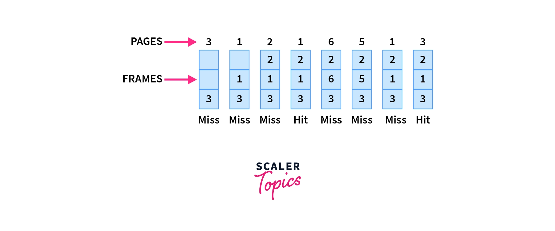


Slide 106
Initially, since all the slots are empty, page 3,1,2 causes a page fault and takes the empty slots
Page faults = 3
When page 1 comes, it is in the memory and no page fault occurs.
Page faults = 3
When page 6 comes, the page fault occurs, we replace the middle element i.e 1 is removed.
Page faults = 4
When page 5 comes, the page fault occurs again and middle element 6 is removed
Page faults = 5

Slide 107
When page 1 comes, there is again a page fault and again the middle element 5 is removed
Page faults = 6
When page 3 comes, it is in memory, hence no page fault occurs.
Total page faults = 6
As we can see, the performance is not the best, but it's also not the worst. The performance in the random replacement algorithm depends on the choice of the page chosen at random.

Slide 108
Advantages
Easy to understand and implement
No extra data structure needed to implement
No overhead
Disadvantages
Can not be analyzed, may produce different performances for the same series
Can suffer from Belady’s anomaly

Slide 109
Q1.
Consider the following page reference string:
1, 2, 3, 4, 2, 1, 5, 6, 2, 1, 2, 3, 7, 6, 3, 2, 1, 2, 3, 6.
How many page faults would occur for the following replacement algorithms, assuming one, two, three, four, five, six, and seven frames? Remember that all frames are initially empty, so your first unique pages will cost one fault each.
• LRU replacement
• FIFO replacement
• Optimal replacement

Slide 110
Q2.
Consider the following page reference string:
7, 2, 3, 1, 2, 5, 3, 4, 6, 7, 7, 1, 0, 5, 4, 6, 2, 3, 0 , 1.
Assuming demand paging with three frames, how many page faults would occur for the following replacement algorithms?
• LRU replacement
• FIFO replacement
• Optimal replacement

Slide 111
Thrashing
Thrashing is directly linked with the degree of multi level programming.
In case, if the page fault and swapping happens very frequently at a higher rate, then the operating system has to spend more time swapping these pages.
This state in the operating system is termed thrashing. Because of thrashing the CPU utilization is going to be reduced.
Let's understand by an example, if any process does not have the number of frames that it needs to support pages in active use then it will quickly page fault.
And at this point, the process must replace some pages. As all the pages of the process are actively in use, it must replace a page that will be needed again right away.
Consequently, the process will quickly fault again, and again, and again, replacing pages that it must bring back in immediately. This high paging activity by a process is called thrashing.
During thrashing, the CPU spends less time on some actual productive work spend more time swapping.

Slide 112
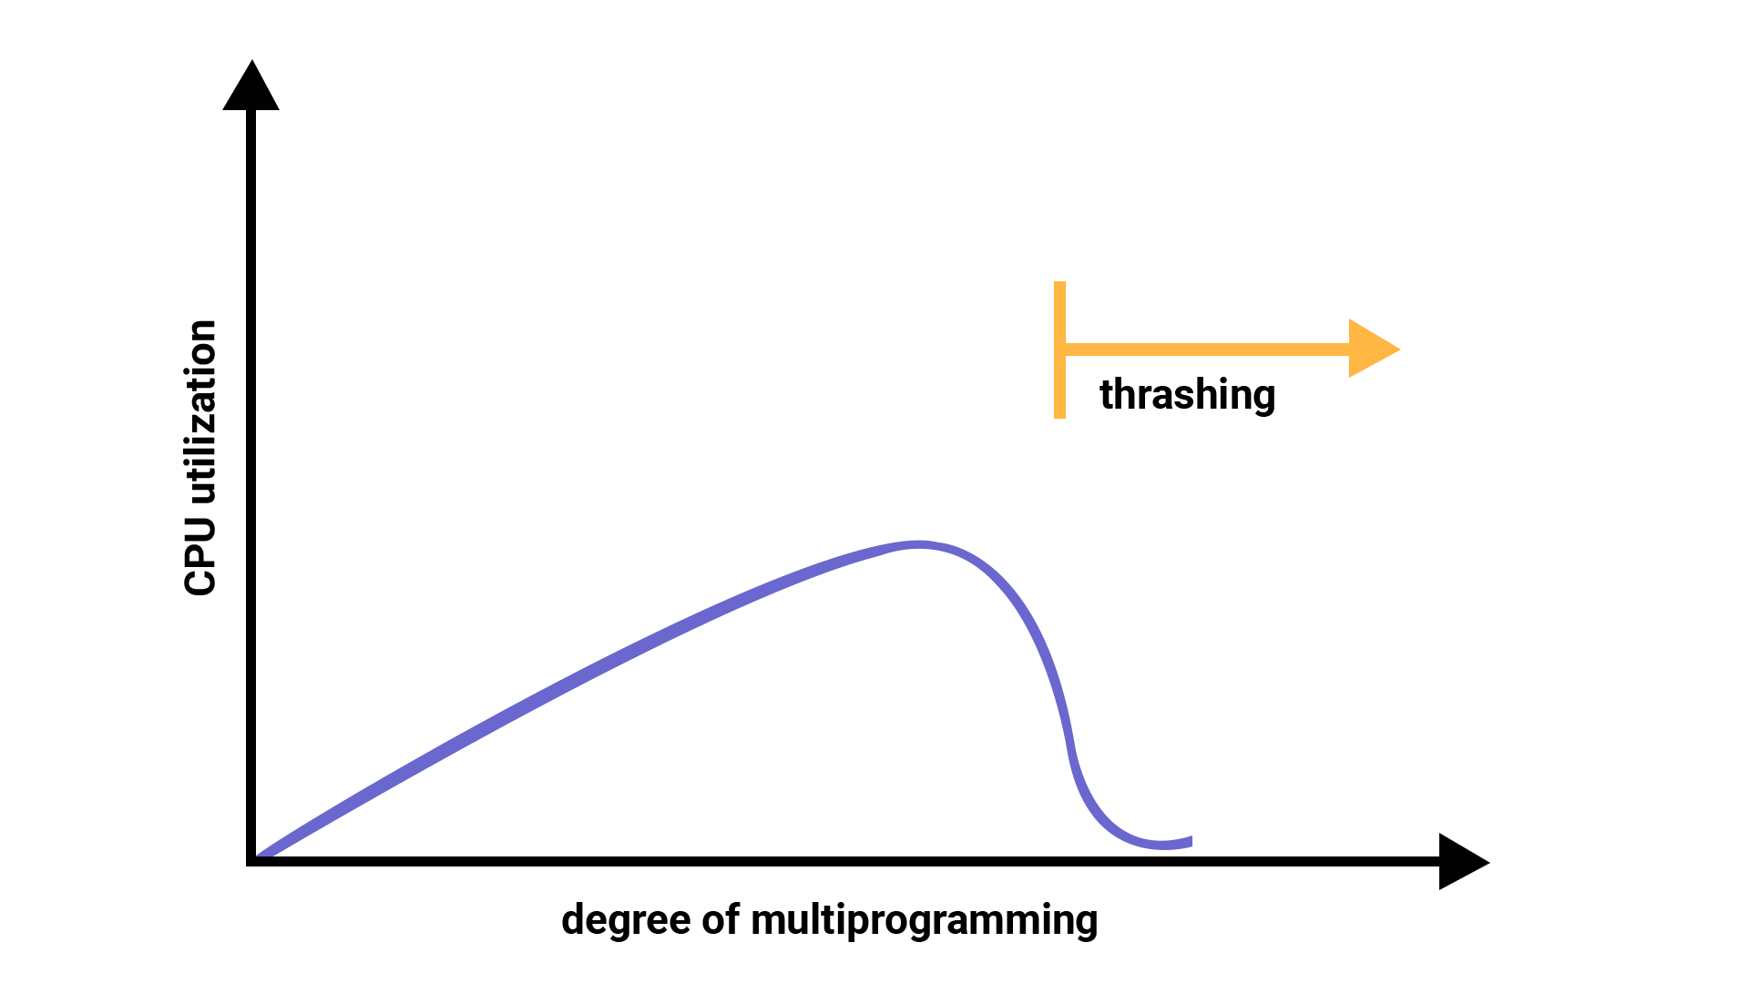

Slide 113
Causes of Thrashing
Thrashing affects the performance of execution in the Operating system. Also, thrashing results in severe performance problems in the Operating system.
When the utilization of CPU is low, then the process scheduling mechanism tries to load many processes into the memory at the same time due to which degree of Multiprogramming can be increased.
Now in this situation, there are more processes in the memory as compared to the available number of frames in the memory. Allocation of the limited amount of frames to each process.
Whenever any process with high priority arrives in the memory and if the frame is not freely available at that time then the other process that has occupied the frame is residing in the frame will move to secondary storage and after that this free frame will be allocated to higher priority process.

Slide 114
We can also say that as soon as the memory fills up, the process starts spending a lot of time for the required pages to be swapped in.
Again the utilization of the CPU becomes low because most of the processes are waiting for pages.
Thus a high degree of multiprogramming and lack of frames are two main causes of thrashing in the Operating system.

Slide 115
Effect of Thrashing
At the time, when thrashing starts then the operating system tries to apply either the Global page replacement Algorithm or the Local page replacement algorithm.
Global Page Replacement
The Global Page replacement has access to bring any page, whenever thrashing found it tries to bring more pages.
Actually, due to this, no process can get enough frames and as a result, the thrashing will increase more and more.
Thus the global page replacement algorithm is not suitable whenever thrashing happens.
Local Page Replacement
Unlike the Global Page replacement, the local page replacement will select pages which only belongs to that process.
Due to this, there is a chance of a reduction in the thrashing. As it is also proved that there are many disadvantages of Local Page replacement.
Thus local page replacement is simply an alternative to Global Page replacement.

Slide 116
Techniques used to handle the thrashing
As we have already told you the Local Page replacement is better than the Global Page replacement but local page replacement has many disadvantages too, so it is not suggestible. Thus given below are some other techniques that are used:
Working-Set Model
This model is based on the assumption of the locality. It makes the use of the parameter in order to define the working-set window.
The main idea is to examine the most recent? page reference. What locality is saying, the recently used page can be used again, and also the pages that are nearby this page will also be used.

Slide 117
1. Working Set
The set of the pages in the most recent? page reference is known as the working set. If a page is in active use, then it will be in the working set. In case if the page is no longer being used then it will drop from the working set ? times after its last reference.
The working set mainly gives the approximation of the locality of the program.
The accuracy of the working set mainly depends on? what is chosen?
This working set model avoids thrashing while keeping the degree of multiprogramming as high as possible.

Slide 118
2.Page Fault Frequency
There is another technique that is used to avoid thrashing and it is Page Fault Frequency(PFF) and it is a more direct approach.
The main problem is how to prevent thrashing. As thrashing has a high page fault rate and also we want to control the page fault rate.
When the Page fault is too high, then we know that the process needs more frames.
Conversely, if the page fault-rate is too low then the process may have too many frames.
We can establish upper and lower bounds on the desired page faults.
If the actual page-fault rate exceeds the upper limit then we will allocate the process to another frame.
And if the page fault rate falls below the lower limit then we can remove the frame from the process.
Thus with this, we can directly measure and control the page fault rate in order to prevent thrashing.

Slide 119
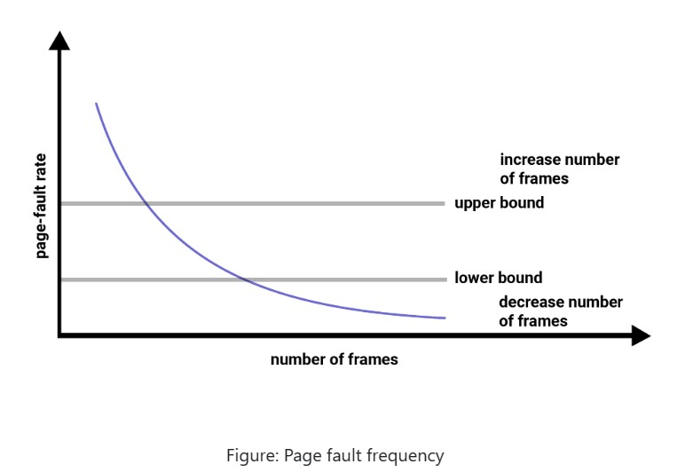

Slide 120
Frame allocation
The main memory of the operating system is divided into various frames.
The process is stored in these frames, and once the process is saved as a frame, the CPU may run it.
As a result, the operating system must set aside enough frames for each process.
As a result, the operating system uses various algorithms in order to assign the frame.
Demand paging is used to implement virtual memory, an essential operating system feature.
It requires the development of a page replacement mechanism and a frame allocation system.
If you have multiple processes, the frame allocation techniques are utilized to define how many frames to allot to each one.
A number of factors constrain the strategies for allocating frames:

Slide 121
You cannot assign more frames than the total number of frames available.
A specific number of frames should be assigned to each process. This limitation is due to two factors. The first is that when the number of frames assigned drops, the page fault ratio grows, decreasing the process's execution performance. Second, there should be sufficient frames to hold all the multiple pages that any instruction may reference.

Slide 122
There are mainly five ways of frame allocation algorithms in the OS. These are as follows:
Equal Frame Allocation
Proportional Frame Allocation
Priority Frame Allocation
Global Replacement Allocation
Local Replacement Allocation

Slide 123
Equal Frame Allocation
In equal frame allocation, the processes are assigned equally among the processes in the OS.
For example, if the system has 30 frames and 7 processes, each process will get 4 frames. The 2 frames that are not assigned to any system process may be used as a free-frame buffer pool in the system.
Disadvantage
In a system with processes of varying sizes, assigning equal frames to each process makes little sense.
Many allotted empty frames will be wasted if many frames are assigned to a small task.

Slide 124
Proportional Frame Allocation
The proportional frame allocation technique assigns frames based on the size needed for execution and the total number of frames in memory.
The allocated frames for a process pi of size si are ai = (si/S)*m, in which S represents the total of all process sizes, and m represents the number of frames in the system.
Disadvantage
The only drawback of this algorithm is that it doesn't allocate frames based on priority. Priority frame allocation solves this problem.

Slide 125
Priority Frame Allocation
Priority frame allocation assigns frames based on the number of frame allocations and the processes.
Suppose a process has a high priority and requires more frames that many frames will be allocated to it.
Following that, lesser priority processes are allocated.

Slide 126
Global Replacement Allocation
In global replacement, since a process selects a replacement frame from the set of all frames, one process can take a frame from another.
This allows a high priority process to select frames from a low priority process.
This may increase the number of frames allocated to a high priority process.
However, the low priority processes will still suffer from page faults, since the high priority process takes frames from the low priority process.
Therefore, the set of pages in memory for a process may depend on the paging behavior of other processes.

Slide 127
Local Replacement Allocation
In local replacement, each process selects from only its own set of allocated frames.
Therefore, the number of frames allocated to a process does not change.
The set of pages in memory for a process is affected by the paging behavior of only that process. But a process may not be able to use other less used pages of other processes.

Slide 128
THANK YOU..!!!!

